Slide 1
The Internet & The Network
Understanding the Components of the Internet

Slide 2
Learning Outcomes
Understand the role of IP addresses in identifying devices on the Internet.
Learn about DNS and its function in translating domain names to IP addresses.
Explore how data is routed across the Internet from one device to with another.

Slide 3
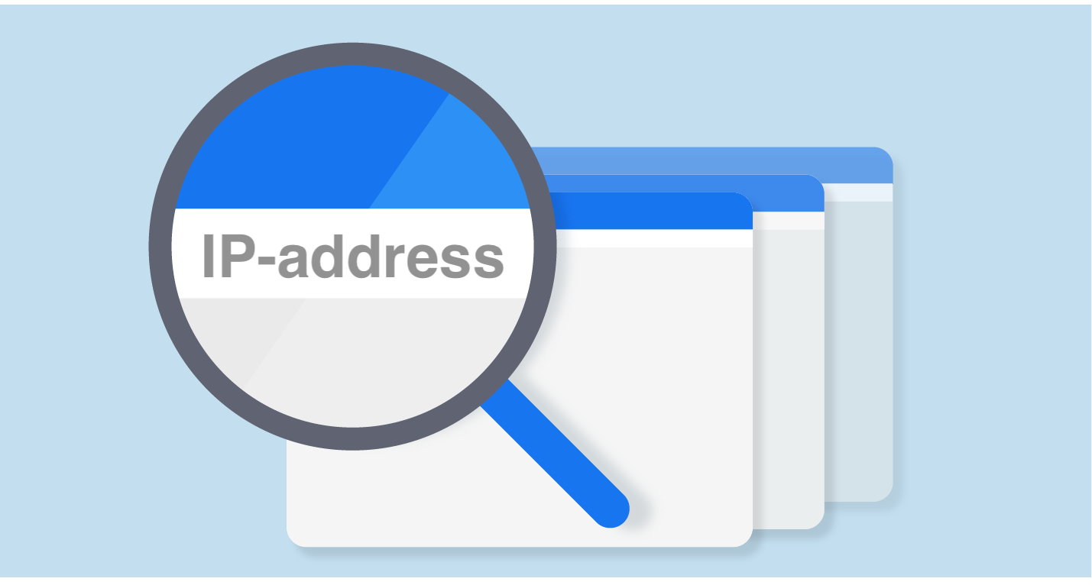
What is an IP Address ?
Definition: An IP address (Internet Protocol address) is a unique string of numbers assigned to every device connected to the Internet. Think of it as the “home address” of your computer on the Internet.
Types of IP Addresses:
IPv4: Made up of four sets of numbers (e.g., 192.168.1.1). Limited in quantity.
IPv6: A newer, larger format to handle the growing number of devices (e.g., 2001:0db8:85a3:0000:0000:8a2e:0370:7334).
Why It Matters: Every website, computer, smartphone, and tablet needs an IP address to send and receive data on the Internet.

Slide 4
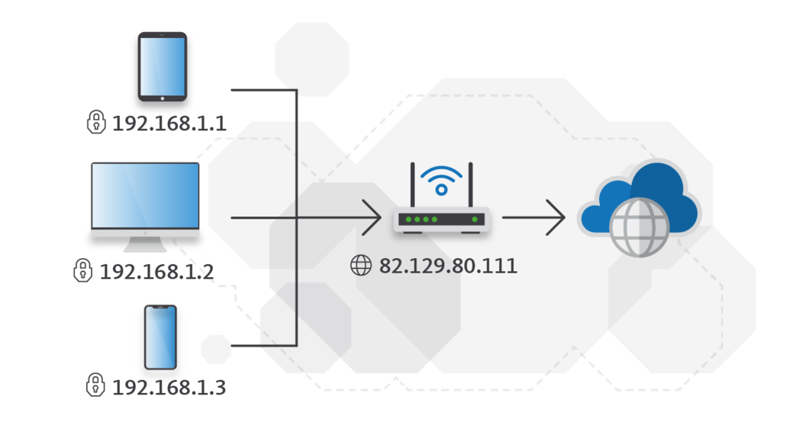
How Do IP Addresses Work?
Uniqueness: Every device has its own unique IP address so that data can be sent and received accurately.
Public vs. Private IPs:
Public IP Address: The address used to communicate with devices outside your network, like websites.
Private IP Address: Used for communication within a local network (e.g., between your home devices).
For example: When you type www.google.com, your device uses its public IP to connect to Google’s server, which has its own IP.

Slide 5
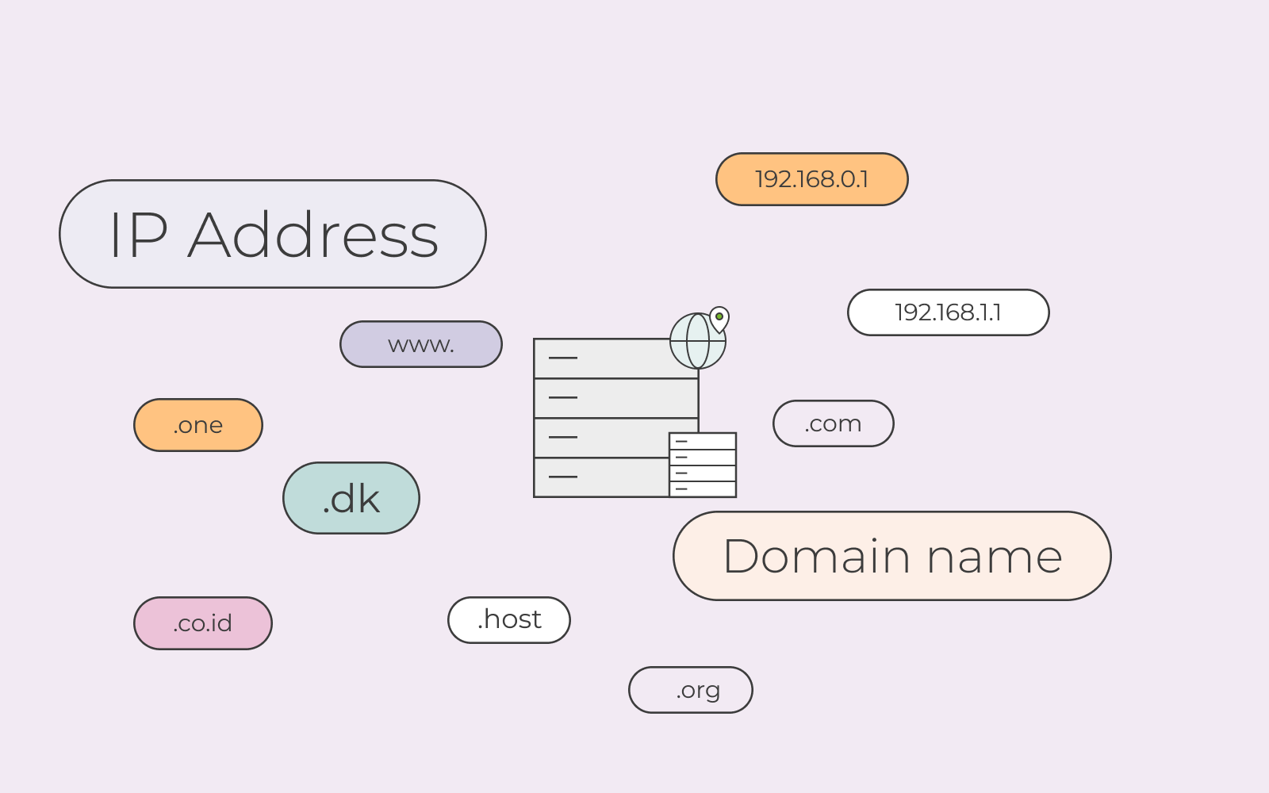
What is DNS ?
Definition: DNS (Domain Name System) translates human-friendly domain names (like www.example.com) into IP addresses that computers can understand.
Why It’s Important: Instead of remembering long IP addresses (like 172.217.14.206), you just need to remember a domain name like google.com. DNS does the conversion for you!
How It Works: When you type a domain name in your browser, your computer contacts a DNS server, which then finds the correct IP address for that domain and connects you.

Slide 6
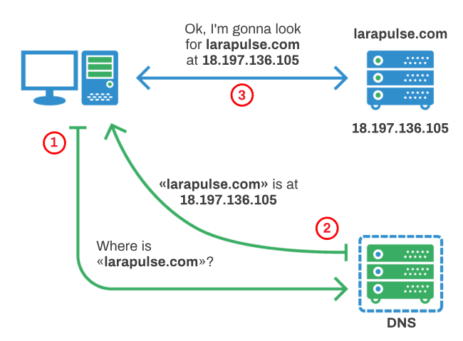
How Does DNS Work ?
Step 1: You type a website URL (like www.example.com) into your browser.
Step 2: Your computer sends a request to a DNS server to find the IP address of that website.
Step 3: The DNS server checks its records. If it doesn’t know the IP address, it contacts other DNS servers.
Step 4: Once the IP address is found, it’s sent back to your computer.
Step 5: Your computer uses the IP address to connect to the website’s server, and the webpage loads!

Slide 7
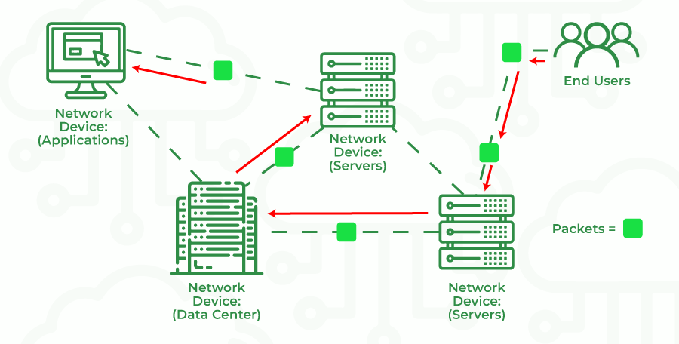
What is Routing ?
Definition: Routing is the process of finding the best path for data to travel from one device to another across the Internet.
Routers: Routers are devices that direct this data traffic. They ensure that data gets from your computer to its destination (e.g., from your laptop to a website’s server) by choosing the fastest and most efficient path.
How It Works: Data is sent in small packets. Each packet can take a different path to reach the destination, depending on the current network conditions. Routers help these packets find their way.

Slide 8
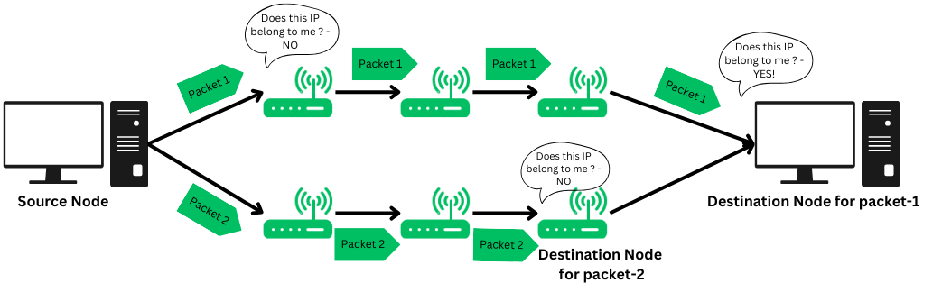
How Does Routing Work ?
Data Packets: When you send data (like a message or request to visit a website), it is broken down into smaller pieces called packets.
Finding the Route: Each packet is sent through the network, hopping from one router to another. The routers decide the best route based on factors like speed and congestion.
Reassembly: Once all the packets reach their destination, they are reassembled to complete the message or webpage.
Example: When you watch a video, every second of that video is broken into packets. These packets may take different routes but are reassembled in order on your screen.

Slide 9
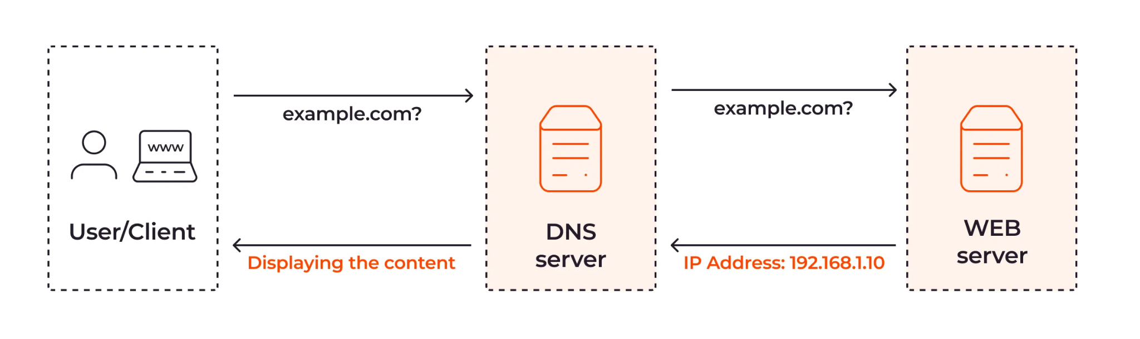
How the Internet’s Components Work Together
Step 1: You type a domain name (like www.example.com) into your browser.
Step 2: Your computer contacts a DNS server to find the website’s IP address.
Step 3: The IP address is found, and your computer connects to the website’s server.
Step 4: Data is sent back and forth in packets, traveling through routers across the Internet.
Step 5: Routers direct the packets to ensure they reach the correct destination, where they are reassembled into a webpage or file.

Slide 10
Key Terms to Remember
IP Address: The unique address identifying each device on the Internet.
DNS (Domain Name System): The system that translates domain names into IP addresses.
Router: A device that directs data traffic across the Internet.
Packets: Small chunks of data sent across the network.
Routing: The process of finding the best path for data to travel.

Slide 11

Conclusion
The Internet relies on several key components like IP addresses, DNS, and routing to function smoothly.
DNS makes it easier for us to use the Internet by converting domain names into IP addresses.
Routers and IP addresses ensure that data is sent to the right place, while packets allow information to travel efficiently across networks.

Slide 12
Activity - MCQs
What is the main purpose of an IP address in networking?
A) To encrypt data for secure transmission
B) To identify devices and facilitate their communication over a network
C) To serve as a storage location for data packets
D) To provide physical addresses for devices

Slide 13
Activity - MCQs
What does DNS stand for?
A) Digital Network System
B) Domain Name System
C) Data Navigation Service
D) Device Network Security

Slide 14
Activity - MCQs
How does DNS help in internet browsing?
A) It translates domain names to IP addresses, allowing browsers to locate and access websites
B) It manages data encryption for secure browsing
C) It provides firewall protection
D) It compresses web data for faster transmission

Slide 15
Activity - MCQs
When data is sent from one device to another across the Internet, what form does it take?
A) Files
B) Packets
C) Scripts
D) Nodes

Slide 16
Activity - MCQs
Which of the following best describes the role of routers in network communication?
A) They provide storage for data packets
B) They direct data packets along the most efficient paths to their destinations
C) They encode data for secure transmission
D) They manage user access to the network

Slide 17
Activity - Answer
B) To identify devices and facilitate their communication over a network
B) Domain Name System
A) It translates domain names to IP addresses, allowing browsers to locate and access websites
B) Packets
B) They direct data packets along the most efficient paths to their destinations

